Slide 1
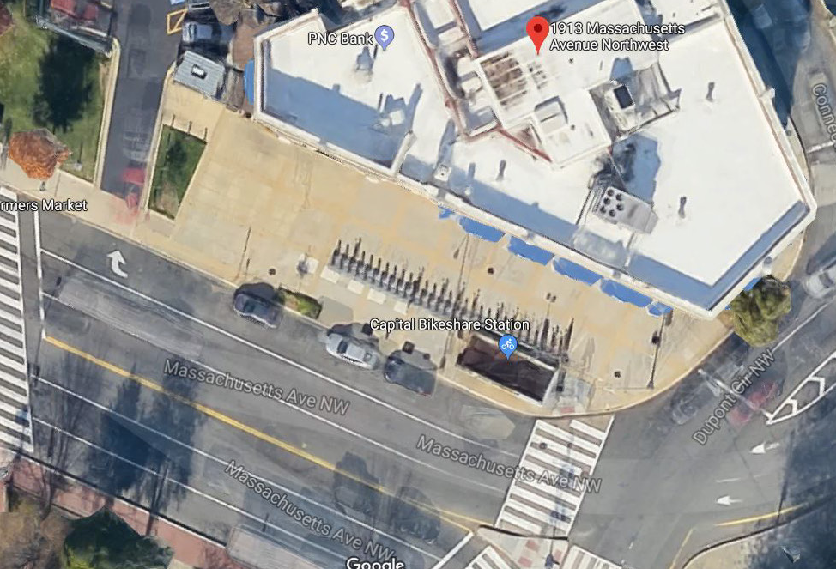
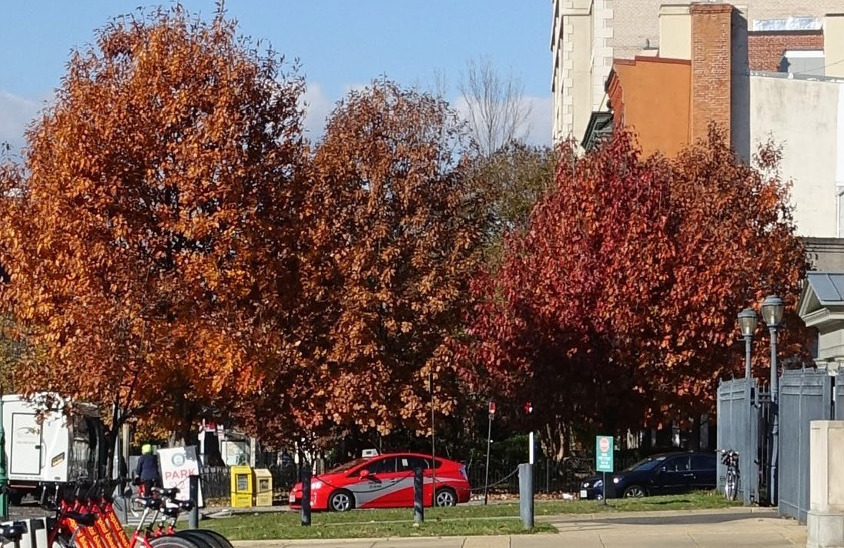
DISTRICT DEPARTMENT OF TRANSPORTATION
Aerial, Source: Google Earth
On Site Street Trees, Source: DDOT
Dupont Tree Plaza Project
Welcome! Thank you for joining us. We will get started shortly.
Notes:
Community based project, thankful for this project. Shout out to partners

Slide 2
DISTRICT DEPARTMENT OF TRANSPORTATION
Dupont Tree Plaza Project
ANC Meeting #1
June 12th, 2024

Slide 3
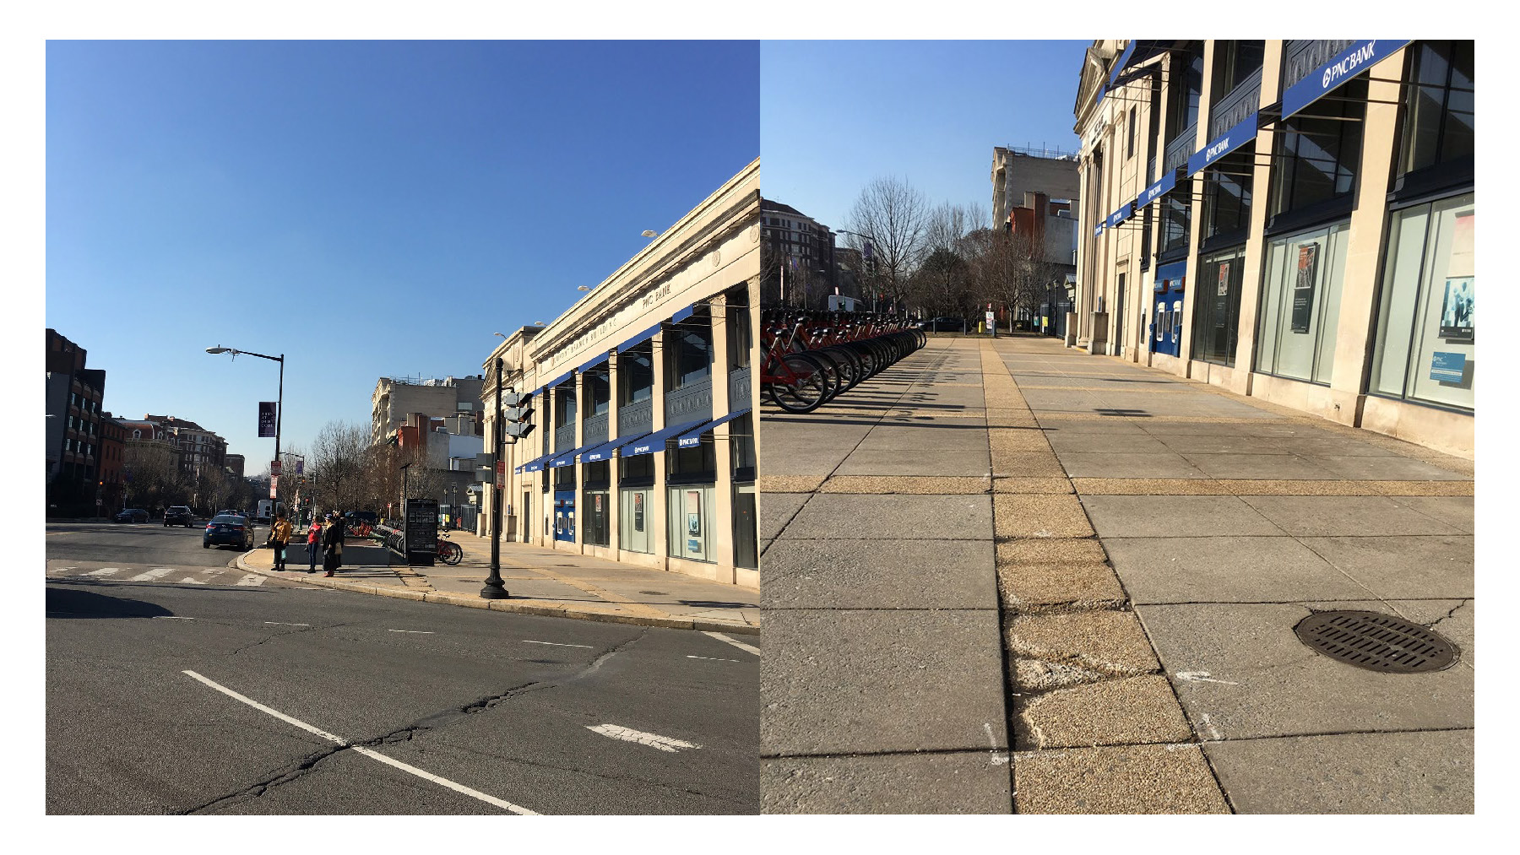
Meeting Agenda
Introductions
Scope
Concept Design Options
  Concept #1
  Concept #2
Project Schedule
Feedback and Q&A
Dupont Circle – Massachusetts Avenue NW, Source: DDOT
Notes:
Annie Tkacik – DDOT Infrastructure and Project Management, green infrastructure and stormwater department
Make sure to mention the two concepts and that we want feedback from them. Only at 15%

Slide 4
Project Scope
The District Department of Transportation (DDOT) is redeveloping the area near Dupont Circle between Massachusetts Avenue NW and Connecticut Avenue NW. This project aims to address the need for a greener, public plaza that can be used by the community. When completed, the plaza will have a larger tree canopy, more greenspace and new pavement. DDOT is currently working on the concept design for this project. The key elements of the Dupont Tree Plaza under design include:
• Green spaces and tree canopy
• Site furnishings and benches
• Soil volume to enhance root growth
• Space for open markets and vendors
Sidewalk, Dupont Circle – Massachusetts Avenue NW, Source: DDOT
Notes:
Greenspace for the community
Double row tree canopy – restore mass avenue
Revitalize the plaza – new pavement, new trees, community gathering space

Slide 5
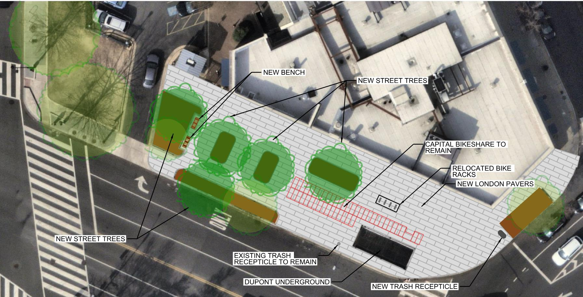
Dupont Tree Plaza – Concept Design A
The key elements of the Dupont Tree Plaza under design include:
Green spaces and tree canopy
Site furnishings and benches
Soil volume to enhance root growth
Maintains all existing Capital Bikeshare racks
Provides less area for farmers market stalls
Notes:
Keeps CaBi station, also proposes 5 trees, keeps trash cans and proposes a trash/recycling center, relocates bike racks.

Slide 6
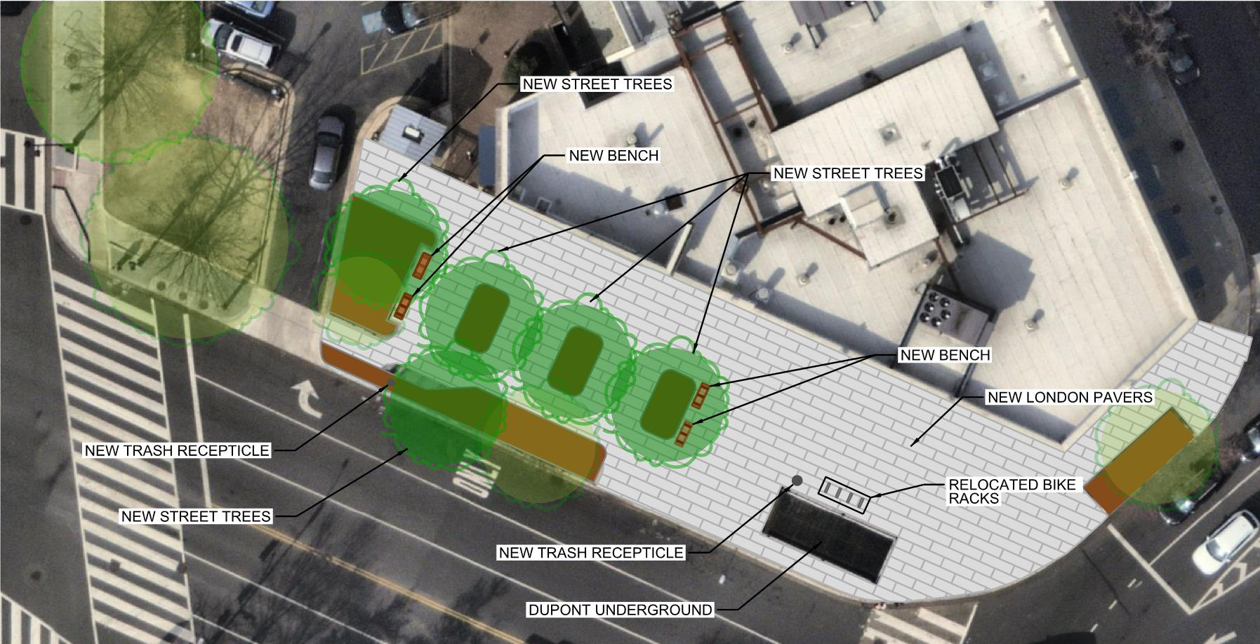
Dupont Tree Plaza – Concept Design B
The key elements of the Dupont Tree Plaza under design include:
Green spaces and tree canopy
Site furnishings and benches
Soil volume to enhance root growth
Relocates all Capital Bikeshare racks off site
Prioritizes greenspace
Maximizes area for farmers market stalls
Notes:
We are relocating the capital bikeshare to allow for more space for the farmers market. This option allows for more green space. Proposing 5 trees. Include 4 benches, and proposes two new trash cans.
Relocates bike racks

Slide 7
Project Timeline
We are here
Outreach
Outreach
6/12/24 ANC 2B Meeting #1 –
Share project background and obtain public input
TBD ANC 2B Meeting #2 –
Share project background and obtain public input
Winter 2024
Final Design Begins
Fall 2024
65% Design Complete
Fall 2024
100% Design Complete
Fall 2026
Anticipated Construction Starts
Winter 2027
Anticipated Construction Complete
Notes:
Absoutely constrained by

Slide 8
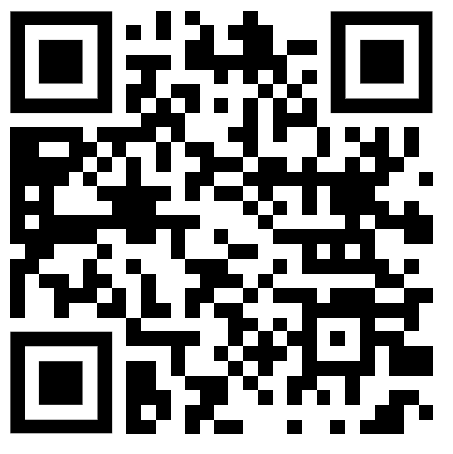
Feedback Options
Project Contact info:
  Annie Tkacik, DDOT Project Manager
  annie.tkacik@dc.gov
  202.830.9758
  Next ANC meeting: Expected September 2024
  https://duponttreeplaza.ddot.dc.gov/
Notes:
Sample of grass panel planter box

Slide 9
Questions?
Notes:
Add a slide after this that includes the benches, trash, etc in case it comes up

Slide 10

250 M St SE | Washington, DC 20003 | 202.673.6813

Slide 11
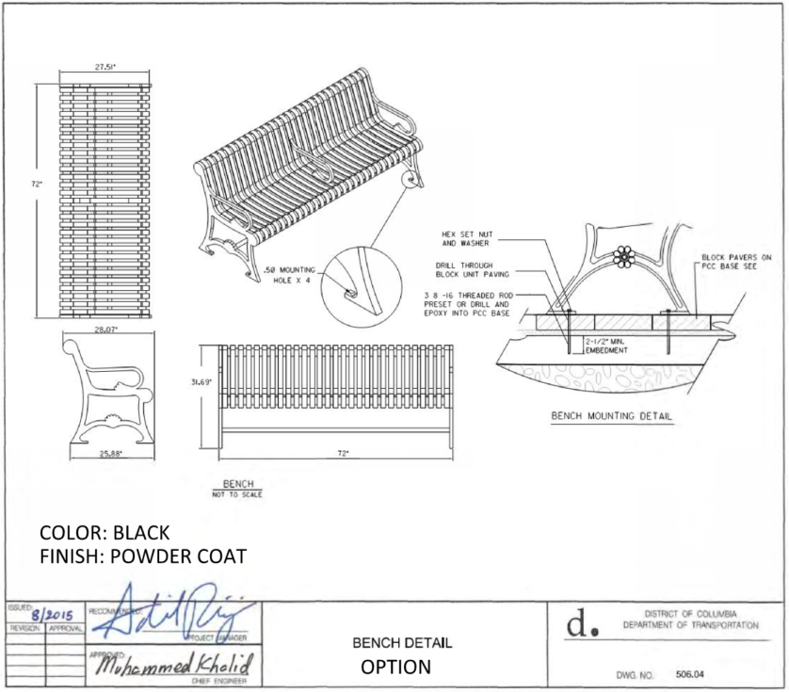
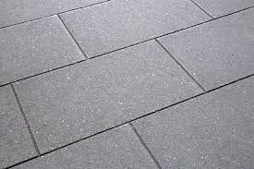
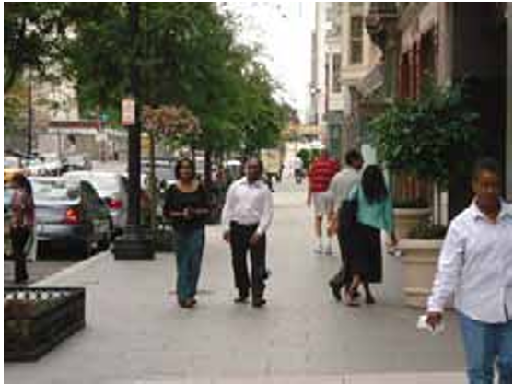
London Pavers
Bench Detail

